Slide 1
Software Engineering
Sobia Iftikhar
Sobia.Iftikhar@nu.edu.pk
Week 04

Slide 2
Content
Agile methods
Agile development techniques
Agile project management
Scaling agile methods

Slide 3
Class 10 03-March-2021

Slide 4
Scaling agile methods
Agile methods have proved to be successful for small and medium sized projects that can be developed by a small co-located team.
It is sometimes argued that the success of these methods comes because of improved communications which is possible when everyone is working together.
Scaling up agile methods involves changing these to cope with larger, longer projects where there are multiple development teams, perhaps working in different locations.

Slide 5
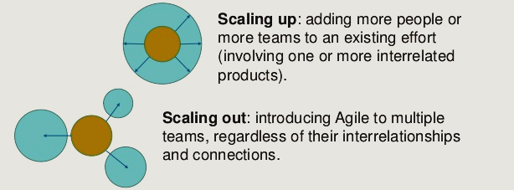
Scaling out and scaling up
‘Scaling up’ is concerned with using agile methods for developing large software systems that cannot be developed by a small team.
‘Scaling out’ is concerned with how agile methods can be introduced across a large organization with many years of software development experience.

Slide 6
When scaling agile methods it is important to maintain agile fundamentals:
Flexible planning
Frequent system releases
Continuous integration
Test-driven development and good team communications.

Slide 7
Practical problems with agile methods
Agile methods are most appropriate for new software development rather than for software maintenance. Yet the majority of software costs in large companies come from maintaining their existing software systems.
Three types of problems can arise:
Lack Of Product Documentation
system requirements document, which tells the software engineer what the system is supposed to do. Without such knowledge, it is difficult to assess the impact of proposed system changes
Keeping Customers Involved
Customer representatives are likely to lose interest in the system.
Development Team Continuity
If an agile development team is broken up, then this implicit knowledge is lost and it is difficult for new team members to build up the same understanding of the system and its components.

Slide 8
Contractor issues
Contractual issues can be a major problem when agile methods are used. When the system customer uses an outside organization for system development, a contract for the software development is drawn up between them.
The software requirements document is usually part of that contract between the customer and the supplier. Because the interleaved development of requirements and code is fundamental to agile methods, there is no definitive statement of requirements that can be included in the contract.

Slide 9
Agile and plan-based factors
Factors influencing the choice of plan-based or agile development

Slide 10
System issues
How large is the system being developed?
Agile methods are most effective a relatively small co-located team who can communicate informally.
What type of system is being developed?
Systems that require a lot of analysis before implementation need a fairly detailed design to carry out this analysis.
What is the expected system lifetime?
Long-lifetime systems require documentation to communicate the intentions of the system developers to the support team.
Is the system subject to external regulation?
If a system is regulated you will probably be required to produce detailed documentation as part of the system safety case.

Slide 11
People and teams
How good are the designers and programmers in the development team?
It is sometimes argued that agile methods require higher skill levels than plan-based approaches in which programmers simply translate a detailed design into code.
How is the development team organized?
Design documents may be required if the team is distributed.
What support technologies are available?
IDE support for visualisation and program analysis is essential if design documentation is not available.

Slide 12
Organizational issues
Traditional engineering organizations have a culture of plan-based development, as this is the norm in engineering.
Is it standard organizational practice to develop a detailed system specification?
Will customer representatives be available to provide feedback of system increments?
Can informal agile development fit into the organizational culture of detailed documentation?

Slide 13
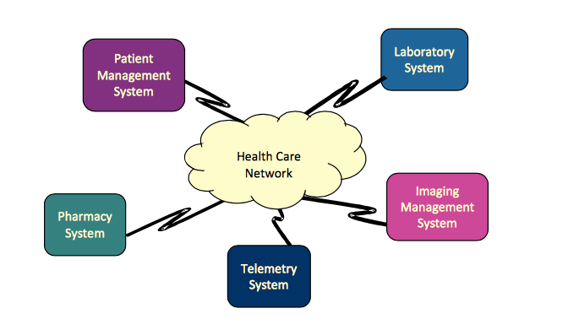
Agile methods for large systems
Large systems are brownfield systems, that is, they include and interact with a number of existing systems.
Large systems are usually collections of separate, communicating systems
Large systems usually have a diverse set of stakeholders with different perspectives and objectives.
Large systems have a long procurement and development time.
Large systems and their development processes are often constrained by external rules and regulations limiting the way that they can be developed,
This is not necessarily compatible with incremental development and frequent system integration.
Notes:
For example, nurses and administrators may be the end-users of a medical system, but senior medical staff, hospital managers, and others, are also stakeholders in the system. It is practically impossible to involve all of these different stakeholders in the development process.

Slide 14
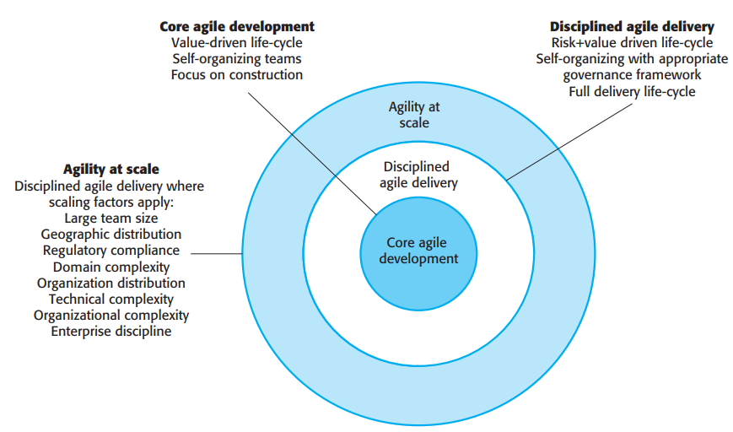
IBM’s Agility at Scale model (© IBM 2010)
Dean Leffingwell has developed the Scaled Agile Framework to support large-scale, multi-team software development.
IBM has also developed a framework for the large-scale use of agile methods called the Agile Scaling Model (ASM).
The Agile Scaling Model (ASM) is a contextual framework for effective adoption and tailoring of agile practices to meet the unique challenges faced by a system delivery team of any size.

Slide 15
Multi-team Scrum
Role replication
Each team has a Product Owner for their work component and ScrumMaster.
Product architects
Each team chooses a product architect and these architects collaborate to design and evolve the overall system architecture.
Release alignment
The dates of product releases from each team are aligned so that a demonstrable and complete system is produced.
Scrum of Scrums
There is a daily Scrum of Scrums where representatives from each team meet to discuss progress and plan work to be done.

Slide 16
Class 11 04-March-2021

Slide 17
Chapter 4 – Requirements Engineering
Functional and non-functional requirements
Requirements engineering processes
Requirements elicitation
Requirements specification
Requirements validation
Requirements change

Slide 18
What is a requirement?
The requirements for a system are the descriptions of the services that a system should provide.
These requirements reflect the needs of customers for a system that serves a certain purpose.
The process of finding out, analyzing, documenting and checking these services and constraints is called requirements engineering (RE).

Slide 19
Types of requirement
User requirements
Statements in natural language plus diagrams of the services the system provides and its operational constraints. Written for customers.
System requirements
A structured document setting out detailed descriptions of the system’s functions, services and operational constraints. Defines what should be implemented so may be part of a contract between client and contractor.

Slide 20
User and system requirements

Slide 21
Stakeholders in the Mentcare system
Patients whose information is recorded in the system.
Doctors who are responsible for assessing and treating patients.
Nurses who coordinate the consultations with doctors and administer some treatments.
Medical receptionists who manage patients’ appointments.
IT staff who are responsible for installing and maintaining the system.

Slide 22
System stakeholders
Any person or organization who is affected by the system in some way and so who has a legitimate interest
Stakeholder types
End users
System managers
System owners
External stakeholders

Slide 23
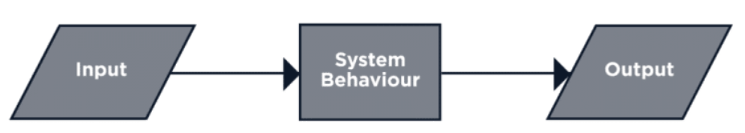
Functional Requirement
What the system does or must not do, and can be thought of in terms of how the system responds to inputs
Functional requirements is what a system is supposed to accomplish. It may be
Calculations
Technical details
Data manipulation
Data processing
Other specific functionality

Slide 24
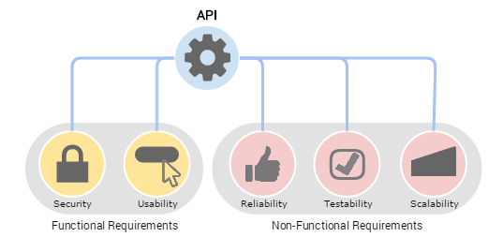
Non-Functional Requirement
Non-functional requirement is a requirement that specifies criteria that can be used to judge the operation of a system in particular conditions, rather than specific behaviors
Non-functional requirements may be more critical than functional requirements. If these are not met, the system may be useless.

Slide 25
Types of nonfunctional requirement

Slide 26
Non-functional classifications
Product requirements
Requirements which specify that the delivered product must behave in a particular way e.g. execution speed, reliability, etc.
Organisational requirements
Requirements which are a consequence of organisational policies and procedures e.g. process standards used, implementation requirements, etc.
External requirements
Requirements which arise from factors which are external to the system and its development process e.g. interoperability requirements, legislative requirements, etc.

Slide 27
Class 12 05-March-2021

Slide 28
Requirements engineering processes
Requirements engineering is an iterative process in which the activities are interleaved.
The activities are organized as an iterative process around a spiral
The output of the RE process is a system requirements document.

Slide 29
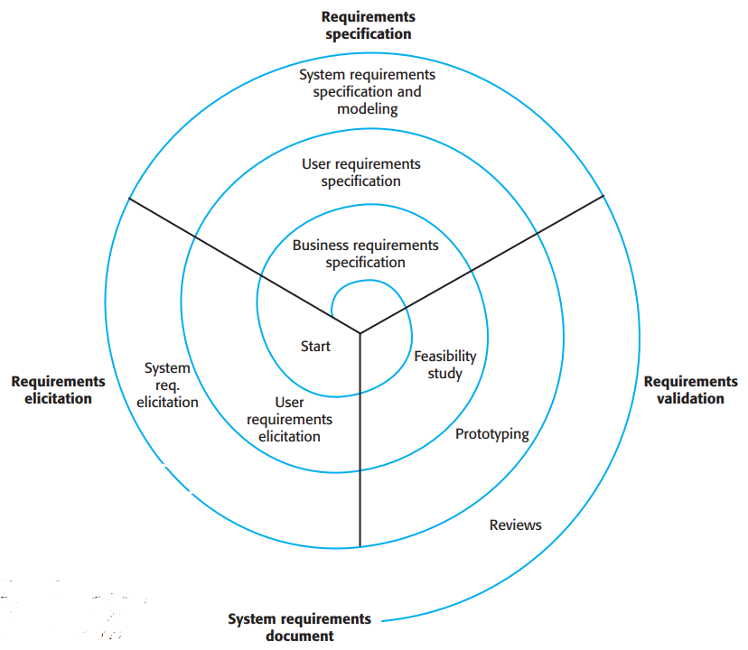
A spiral view of the requirements engineering process

Slide 30
Requirements elicitation and analysis
Sometimes called requirements elicitation or requirements discovery.
Involves technical staff working with customers to find out about the application domain, the services that the system should provide and the system’s operational constraints.
May involve end-users, managers, engineers involved in maintenance, domain experts, trade unions, etc. These are called stakeholders.

Slide 31
Requirements elicitation
Software engineers work with a range of system stakeholders to find out about the application domain, the services that the system should provide, the required system performance, hardware constraints, other systems, etc.
Stages include:
Requirements discovery,
Requirements classification and organization,
Requirements prioritization and negotiation,
Requirements specification.

Slide 32
The requirements elicitation and analysis process

Slide 33
Process activities
Requirements discovery
Interacting with stakeholders to discover their requirements. Domain requirements are also discovered at this stage.
Requirements classification and organisation
Groups related requirements and organises them into coherent clusters.
Prioritisation and negotiation
Prioritising requirements and resolving requirements conflicts.
Requirements specification
Requirements are documented and input into the next round of the spiral.

Slide 34
Interviewing
Formal or informal interviews with stakeholders are part of most RE processes.
Types of interview
Closed interviews based on pre-determined list of questions
Open interviews where various issues are explored with stakeholders.
Effective interviewing
Be open-minded, avoid pre-conceived ideas about the requirements and are willing to listen to stakeholders.
Prompt the interviewee to get discussions going using a springboard question, a requirements proposal, or by working together on a prototype system.

Slide 35
Ethnography
ethnography is an indirect methodology where consumers’ natural behavior in their everyday environment is observed.
A social scientist spends a considerable time observing and analysing how people actually work.
People do not have to explain or articulate their work.
Social and organisational factors of importance may be observed.
Ethnographic studies have shown that work is usually richer and more complex than suggested by simple system models.

Slide 36
Ethnography and prototyping for requirements analysis

Slide 37
Requirements specification
The process of writing down the user and system requirements in a requirements document.
User requirements must be understandable by end-users and customers who do not have a technical background.
System requirements are more detailed requirements and may include more technical information.
The requirements may be part of a contract for the system development
It is therefore important that these are as complete as possible.

Slide 38
Ways of writing a system requirements specification
Notation | Description
Natural language | The requirements are written using numbered sentences in natural language. Each sentence should express one requirement.
Structured natural language | The requirements are written in natural language on a standard form or template. Each field provides information about an aspect of the requirement.
Design description languages | This approach uses a language like a programming language, but with more abstract features to specify the requirements by defining an operational model of the system. This approach is now rarely used although it can be useful for interface specifications.
Graphical notations | Graphical models, supplemented by text annotations, are used to define the functional requirements for the system; UML use case and sequence diagrams are commonly used.
Mathematical specifications | These notations are based on mathematical concepts such as finite-state machines or sets. Although these unambiguous specifications can reduce the ambiguity in a requirements document, most customers don’t understand a formal specification. They cannot check that it represents what they want and are reluctant to accept it as a system contract

Slide 39
Structured specifications
An approach to writing requirements where the freedom of the requirements writer is limited and requirements are written in a standard way.
This works well for some types of requirements e.g. requirements for embedded control system but is sometimes too rigid for writing business system requirements.

Slide 40
Users of a requirements document

Slide 41
Requirements document variability
Information in requirements document depends on type of system and the approach to development used.
Systems developed incrementally will, typically, have less detail in the requirements document.
Requirements documents standards have been designed e.g. IEEE standard. These are mostly applicable to the requirements for large systems engineering projects.

Slide 42
The structure of a requirements document
Chapter | Description
Preface | This should define the expected readership of the document and describe its version history, including a rationale for the creation of a new version and a summary of the changes made in each version.
Introduction | This should describe the need for the system. It should briefly describe the system’s functions and explain how it will work with other systems. It should also describe how the system fits into the overall business or strategic objectives of the organization commissioning the software.
Glossary | This should define the technical terms used in the document. You should not make assumptions about the experience or expertise of the reader.
User requirements definition | Here, you describe the services provided for the user. The nonfunctional system requirements should also be described in this section. This description may use natural language, diagrams, or other notations that are understandable to customers. Product and process standards that must be followed should be specified.
System architecture | This chapter should present a high-level overview of the anticipated system architecture, showing the distribution of functions across system modules. Architectural components that are reused should be highlighted.

Slide 43
The structure of a requirements document
Chapter | Description
System requirements specification | This should describe the functional and nonfunctional requirements in more detail. If necessary, further detail may also be added to the nonfunctional requirements. Interfaces to other systems may be defined.
System models | This might include graphical system models showing the relationships between the system components and the system and its environment. Examples of possible models are object models, data-flow models, or semantic data models.
System evolution | This should describe the fundamental assumptions on which the system is based, and any anticipated changes due to hardware evolution, changing user needs, and so on. This section is useful for system designers as it may help them avoid design decisions that would constrain likely future changes to the system.
Appendices | These should provide detailed, specific information that is related to the application being developed; for example, hardware and database descriptions. Hardware requirements define the minimal and optimal configurations for the system. Database requirements define the logical organization of the data used by the system and the relationships between data.
Index | Several indexes to the document may be included. As well as a normal alphabetic index, there may be an index of diagrams, an index of functions, and so on.

Slide 44
Requirements validation

Slide 45
Requirements validation
Concerned with demonstrating that the requirements define the system that the customer really wants.
Requirements error costs are high so validation is very important
Fixing a requirements error after delivery may cost up to 100 times the cost of fixing an implementation error.

Slide 46
Requirements checking
Validity. Does the system provide the functions which best support the customer’s needs?
Consistency. Are there any requirements conflicts?
Completeness. Are all functions required by the customer included?
Realism. Can the requirements be implemented given available budget and technology
Verifiability. Can the requirements be checked?

Slide 47
Requirements validation techniques
Requirements reviews
Systematic manual analysis of the requirements.
Prototyping
Using an executable model of the system to check requirements. Covered in Chapter 2.
Test-case generation
Developing tests for requirements to check testability.

Slide 48
Requirements reviews
Regular reviews should be held while the requirements definition is being formulated.
Both client and contractor staff should be involved in reviews.
Reviews may be formal (with completed documents) or informal. Good communications between developers, customers and users can resolve problems at an early stage.

Slide 49
Review checks
Verifiability
Is the requirement realistically testable?
Comprehensibility
Is the requirement properly understood?
Traceability
Is the origin of the requirement clearly stated?
Adaptability
Can the requirement be changed without a large impact on other requirements?

Slide 50
Requirements change

Slide 51
Changing requirements
The business and technical environment of the system always changes after installation.
New hardware may be introduced, it may be necessary to interface the system with other systems, business priorities may change (with consequent changes in the system support required), and new legislation and regulations may be introduced that the system must necessarily abide by.
The people who pay for a system and the users of that system are rarely the same people.
System customers impose requirements because of organizational and budgetary constraints. These may conflict with end-user requirements and, after delivery, new features may have to be added for user support if the system is to meet its goals.

Slide 52
Requirements evolution

Slide 53
Requirements management
Requirements management is the process of managing changing requirements during the requirements engineering process and system development.
New requirements emerge as a system is being developed and after it has gone into use.
You need to keep track of individual requirements and maintain links between dependent requirements so that you can assess the impact of requirements changes. You need to establish a formal process for making change proposals and linking these to system requirements.

Slide 54
Requirements change management
Deciding if a requirements change should be accepted
Problem analysis and change specification
During this stage, the problem or the change proposal is analyzed to check that it is valid. This analysis is fed back to the change requestor who may respond with a more specific requirements change proposal, or decide to withdraw the request.
Change analysis and costing
The effect of the proposed change is assessed using traceability information and general knowledge of the system requirements. Once this analysis is completed, a decision is made whether or not to proceed with the requirements change.
Change implementation
The requirements document and, where necessary, the system design and implementation, are modified. Ideally, the document should be organized so that changes can be easily implemented.

Slide 55
Requirements change management

Slide 56
Thankyou

